Slide 1
CLOUD COMPUTING
Sabyasachi

Slide 2
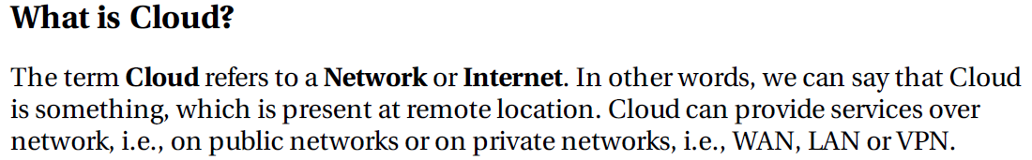
Cloud Computing Overview

Slide 3
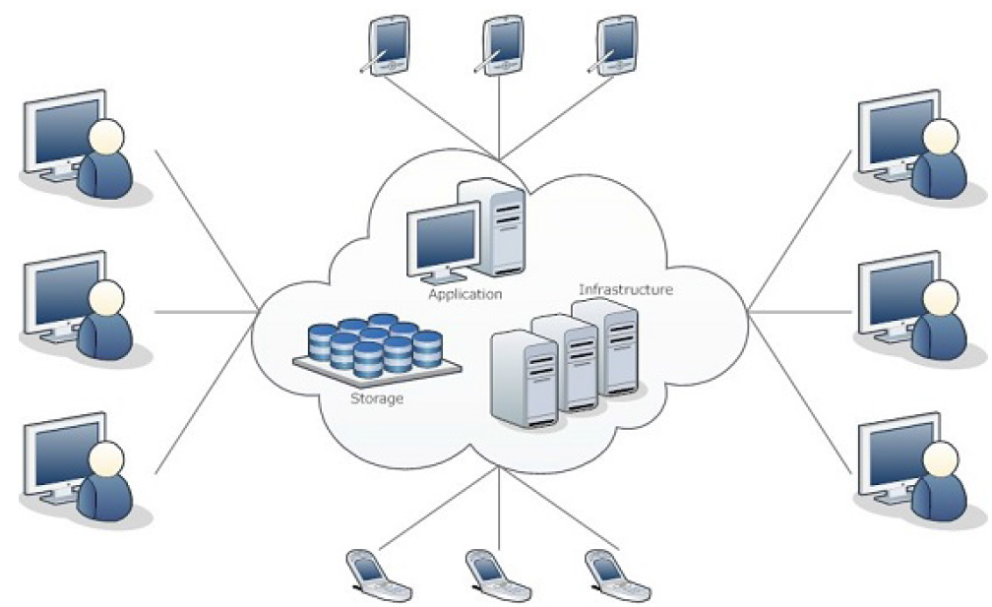
What is Cloud Computing

Slide 4
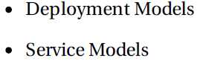
Basic Concepts

Slide 5
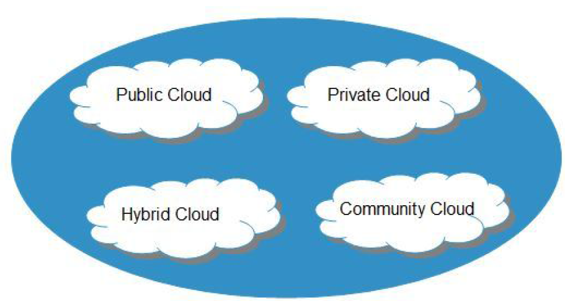
Deployment Models

Slide 6
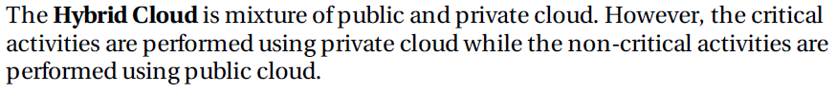
Deployment Models

Slide 7
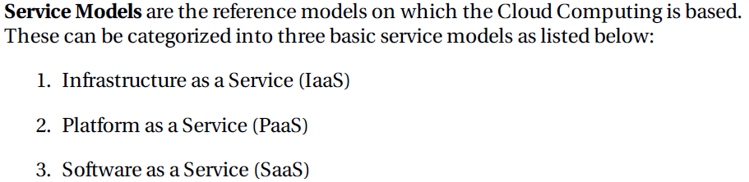
Service Models

Slide 8
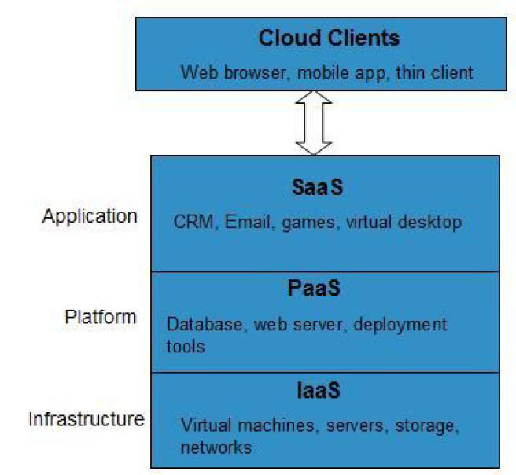
Service Models

Slide 9
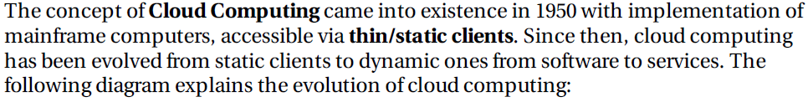
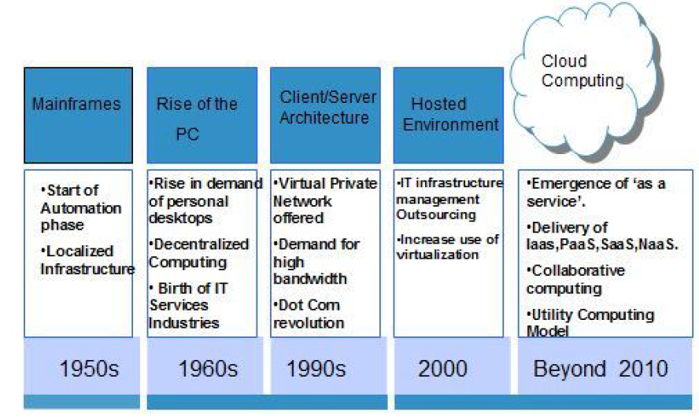
Cloud History

Slide 10
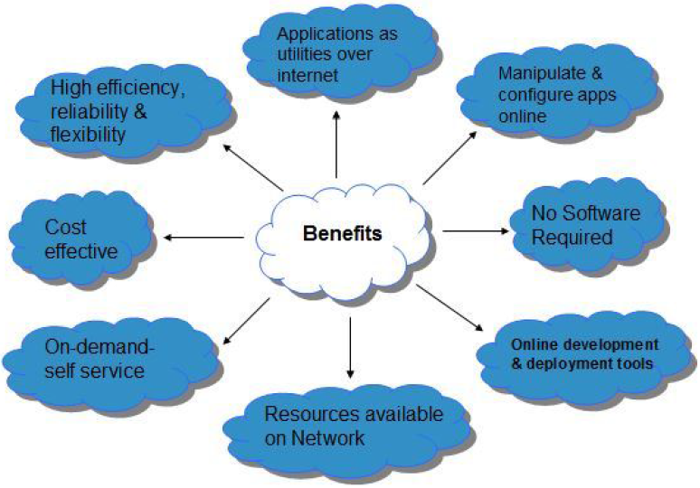
Benefits of Cloud Computing

Slide 11
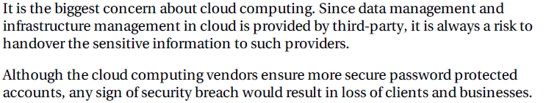
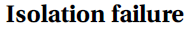
Risks in Cloud Computing

Slide 12
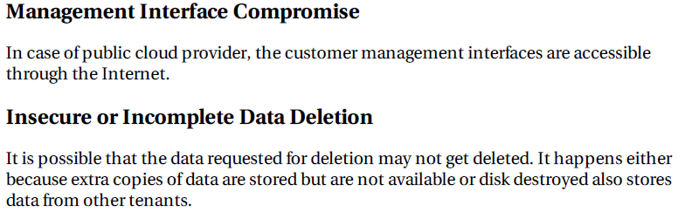
Risks in Cloud Computing

Slide 13
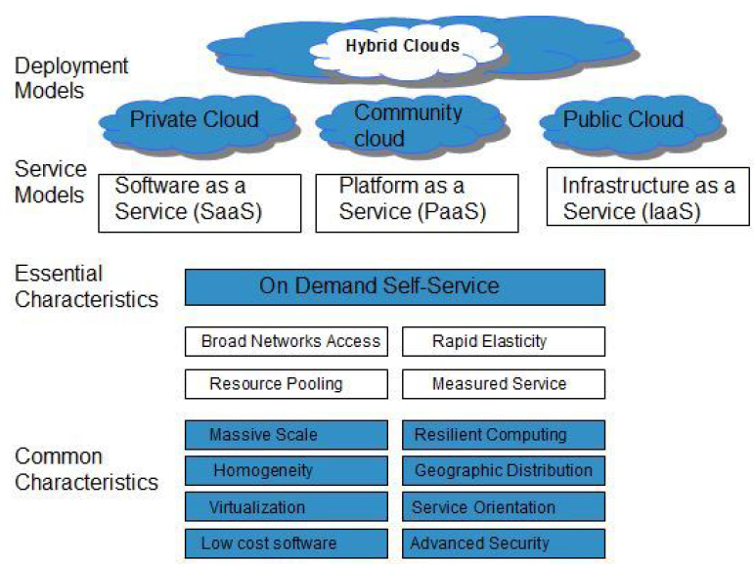
Characteristics of Cloud Computing

Slide 14
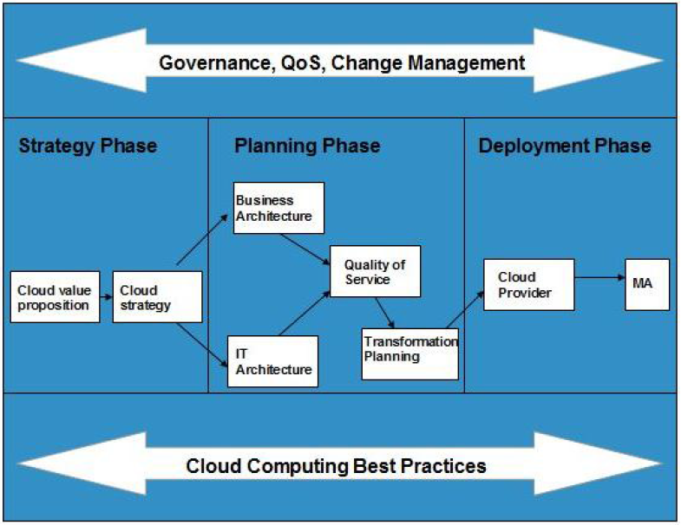
Cloud Computing Planning

Slide 15
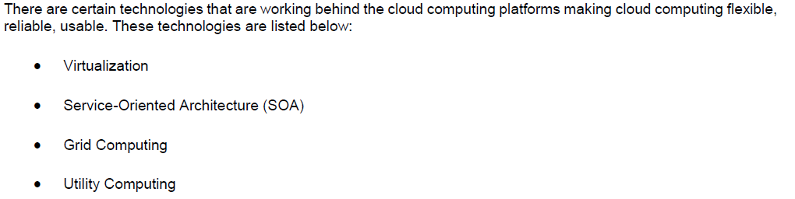
Cloud Computing Technologies

Slide 16
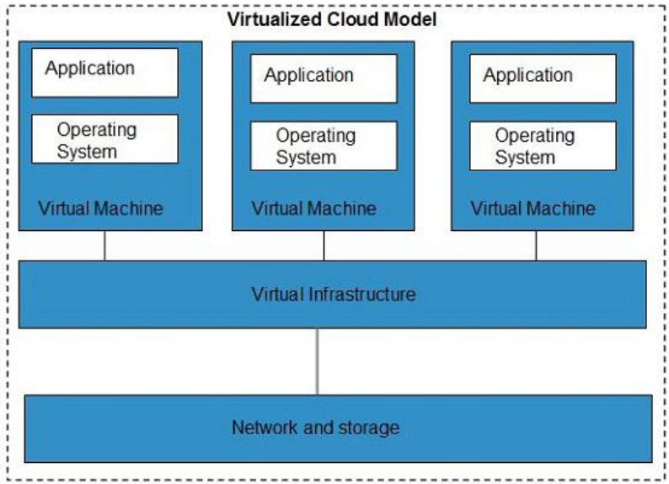
Virtualization

Slide 17
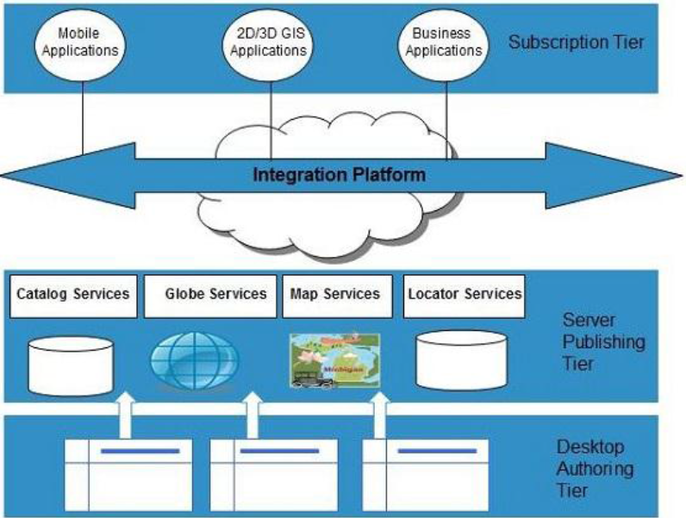
Service-Oriented Architecture (SOA)

Slide 18
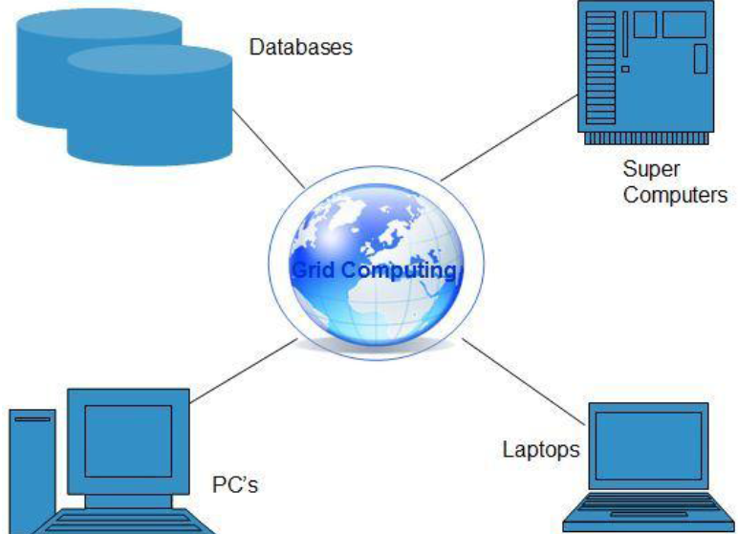
Grid Computing

Slide 19
Utility Computing

Slide 20
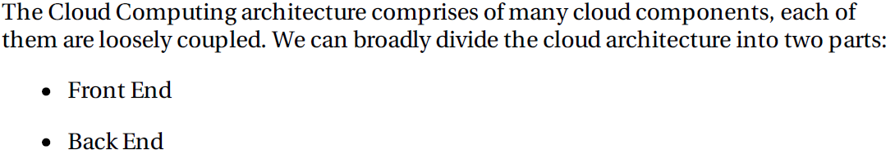
Cloud Computing Architecture

Slide 21
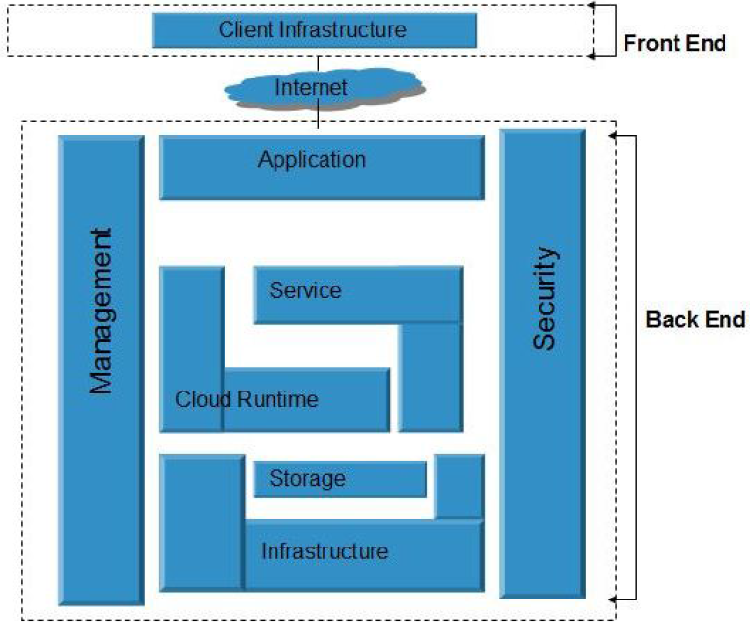
Cloud Computing Architecture

Slide 22
Thank you!

